Slide 1
Project 2 Rental Home Prediction
Leo Liu

Slide 2


Objective
Evaluate a property
Budget your rental

Slide 3
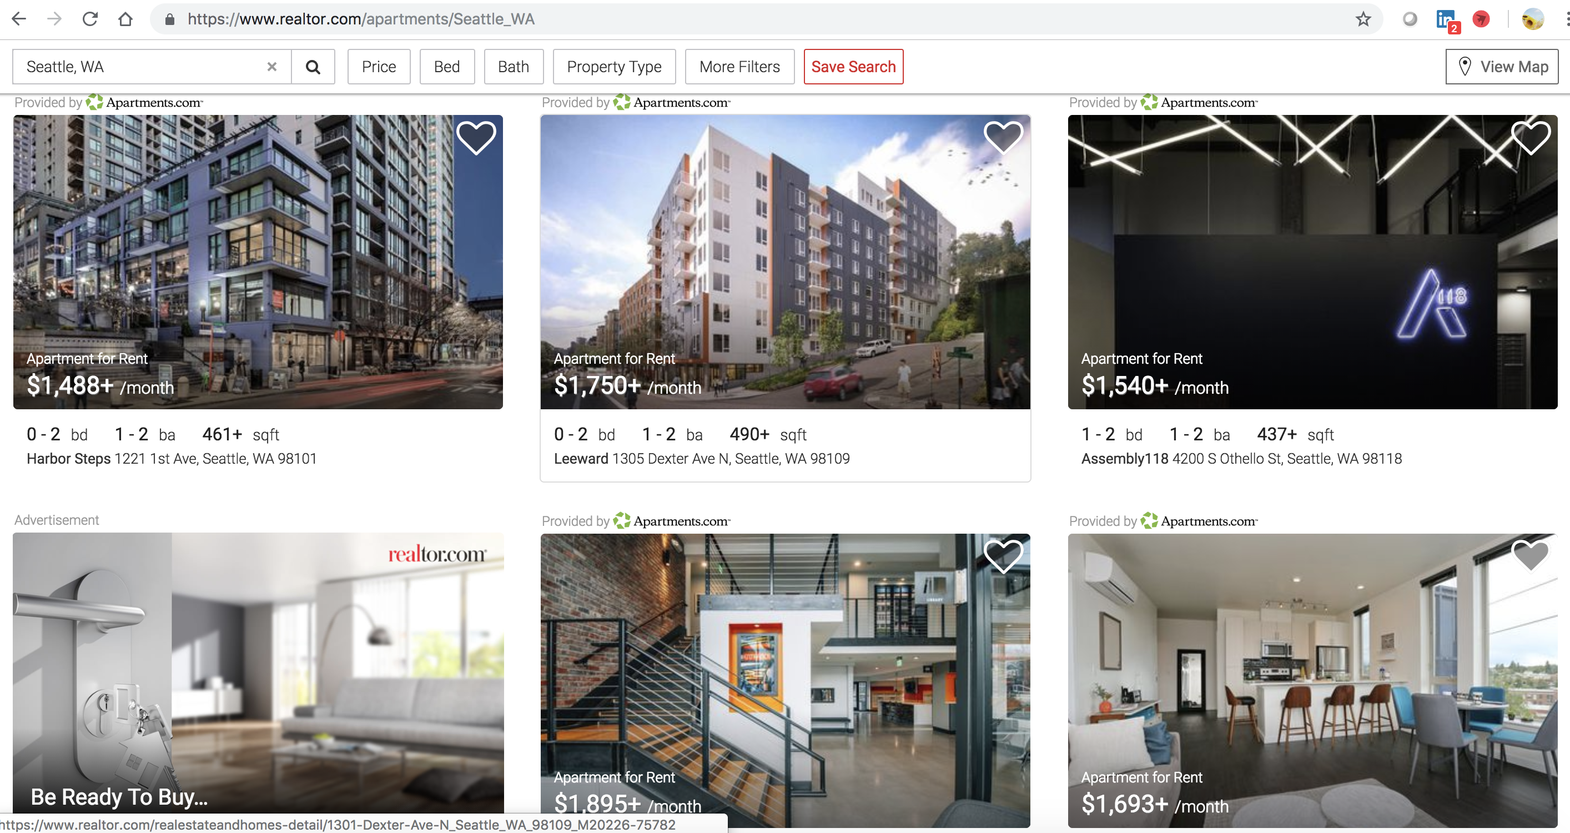
Data Source

Slide 4


Process
1
Web Scrapping
2
Data Cleaning
Get URLs
Iterate over pages
Scrap each single page
Account for only popular community and unit features
3
Modeling
4
Training & Testing
MVP
Feature Screening
Polynomial Features
Variable Transformation
Check overfitting

Slide 5
Model
Features:
Responses:
Rental Price
Bedrooms | Bathrooms
Sqft | YearBulit
Schools | Average School Rating
Community Features | Unit Features
Median Rental Price | Median Listing Price

Slide 6
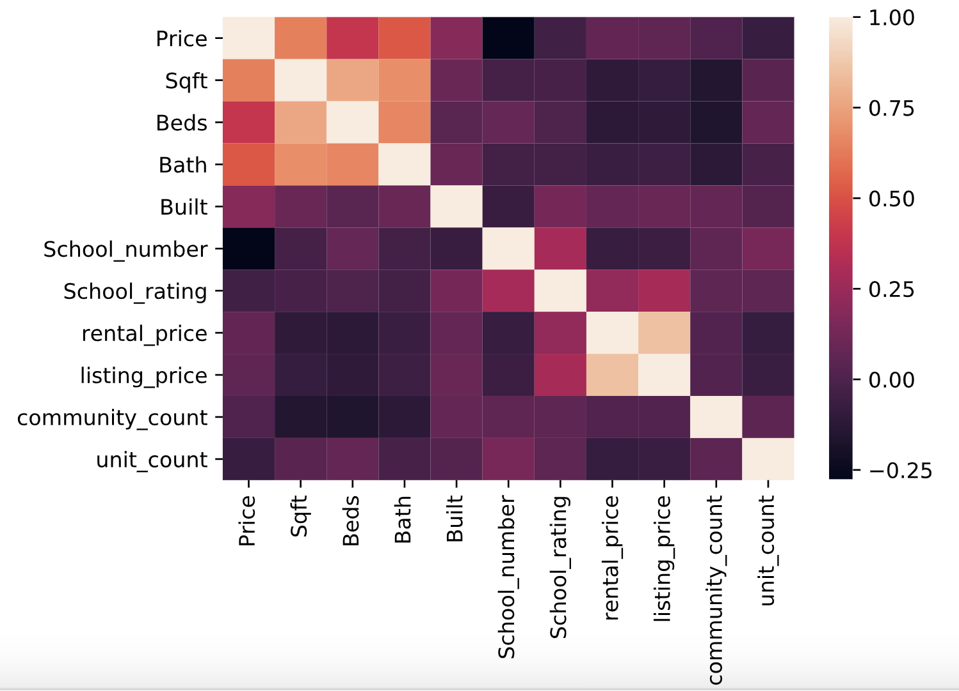
Model
Check multicollinearity

Slide 7
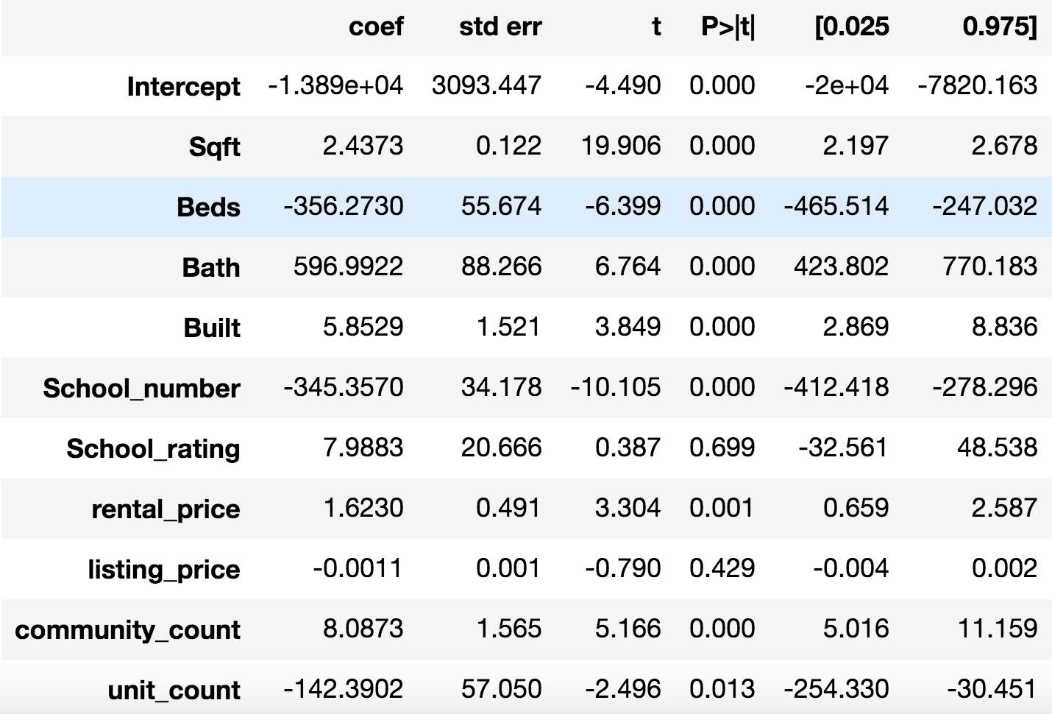
Model
Check p-values

Slide 8
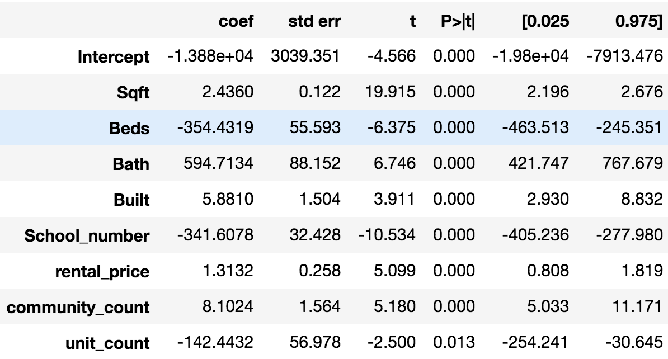
Model
Feature Screening

Slide 9
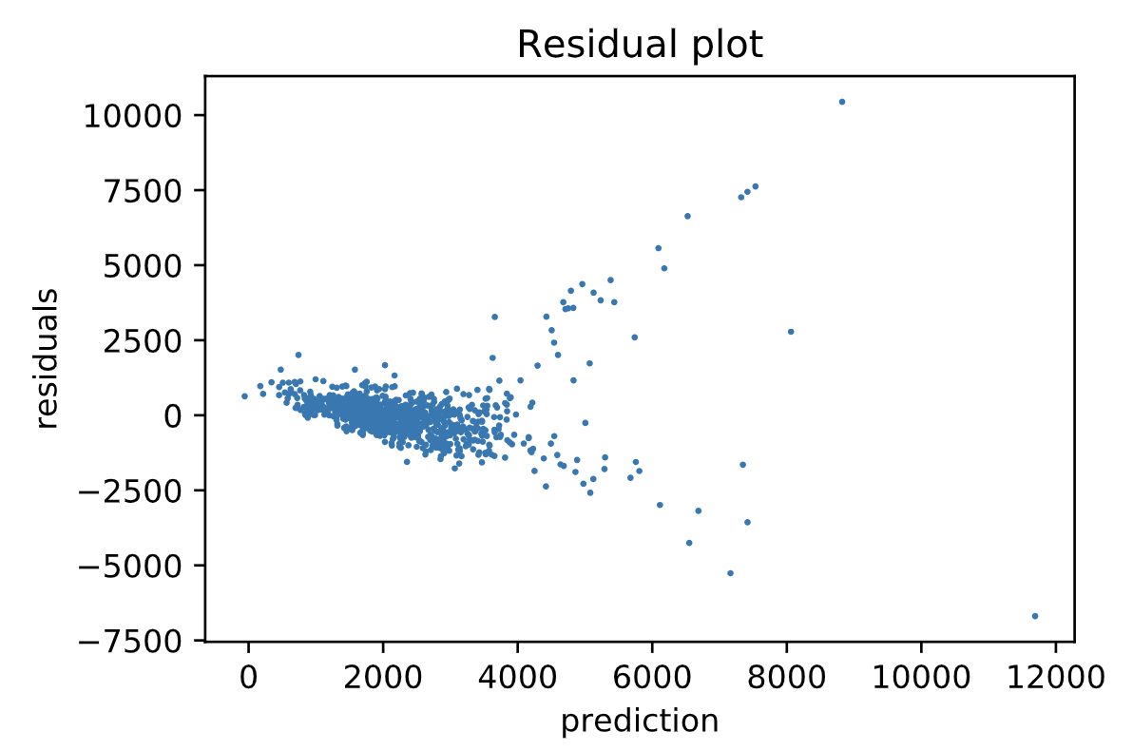
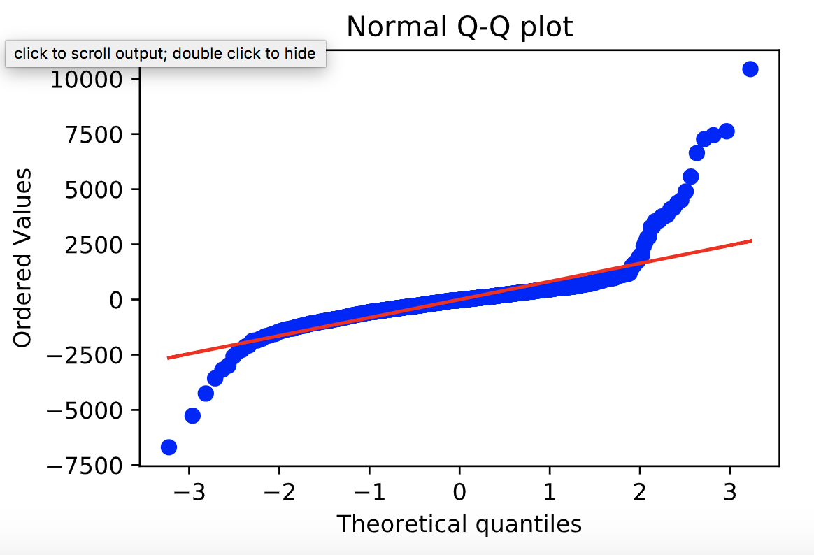
Model
Check heteroskedasticity
Residual plot and Normal Q-Q plot of 2-degree polynomial feature regression model

Slide 10
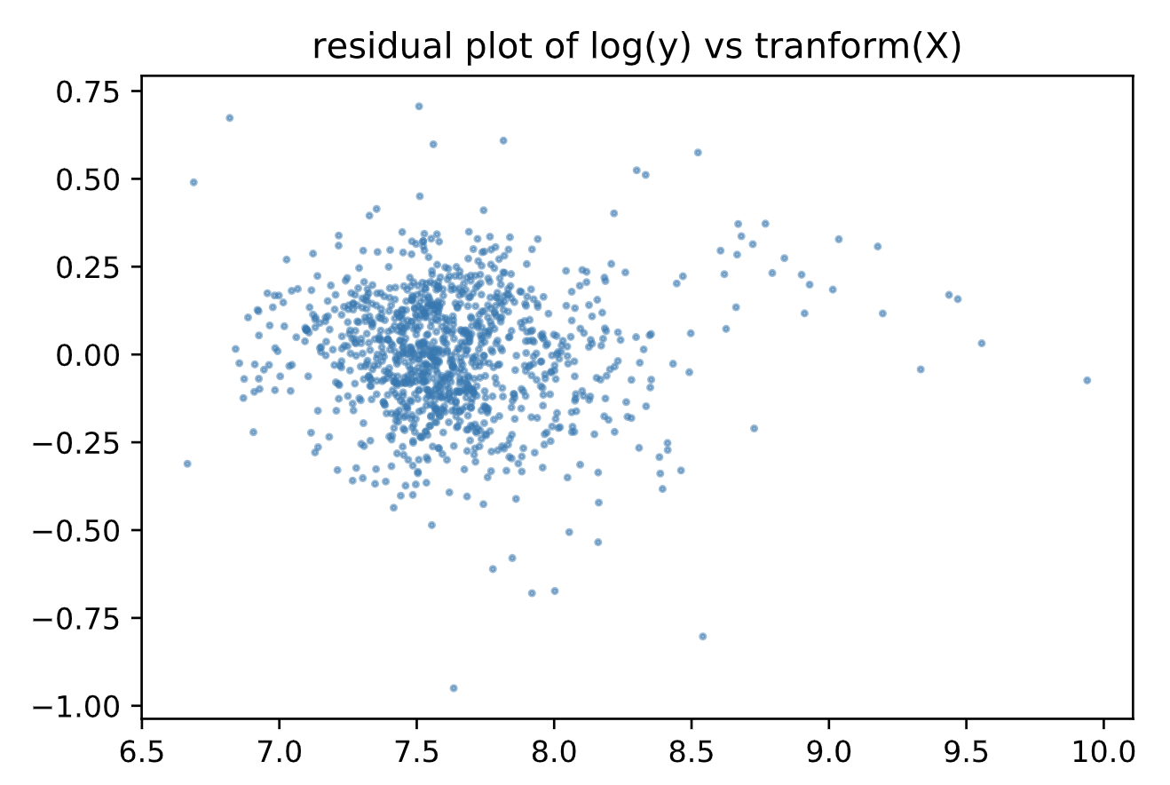
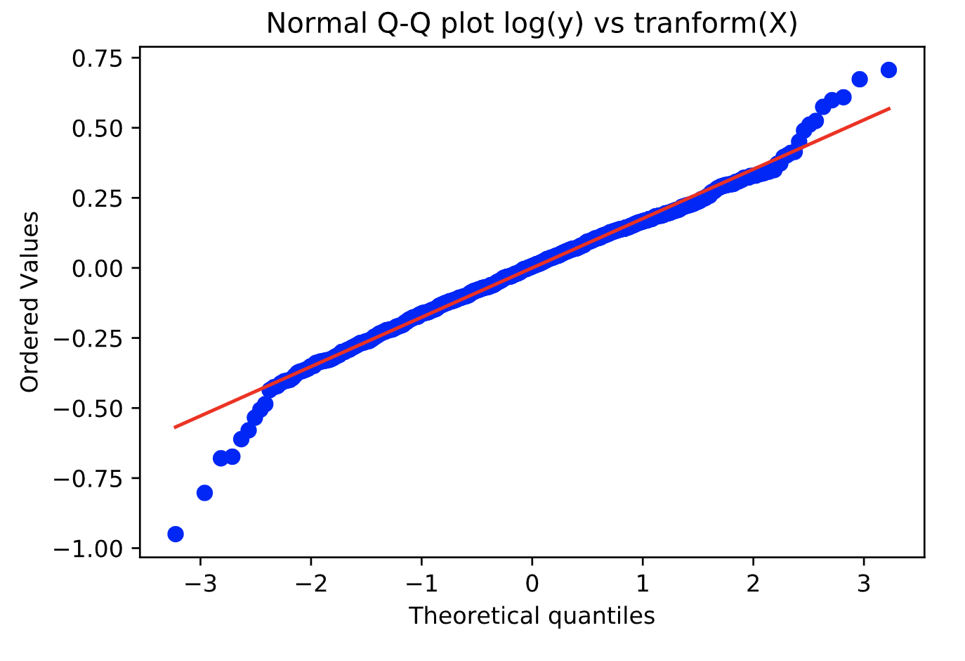
Model
Check heteroskedasticity
Residual plot and Normal Q-Q plot of 2-degree polynomial feature regression model with transformed variables

Slide 11
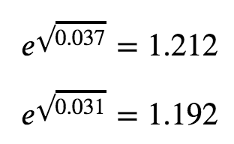
Train and Test
Cross Validation on Training Data
R-Squared = 0.730 +/- 0.033
Mean Squared Error = 0.041 +/- 0.010
Check Overfitting
R-Squared(Train) = 0.791
R-Squared(Test) = 0.780
Mean Squared Error(Train) = 0.031
Mean Squared Error(Test) = 0.037
So the final deviation between train and test is about 1.212/1.192 - 1 ≈ 1.6%

Slide 12
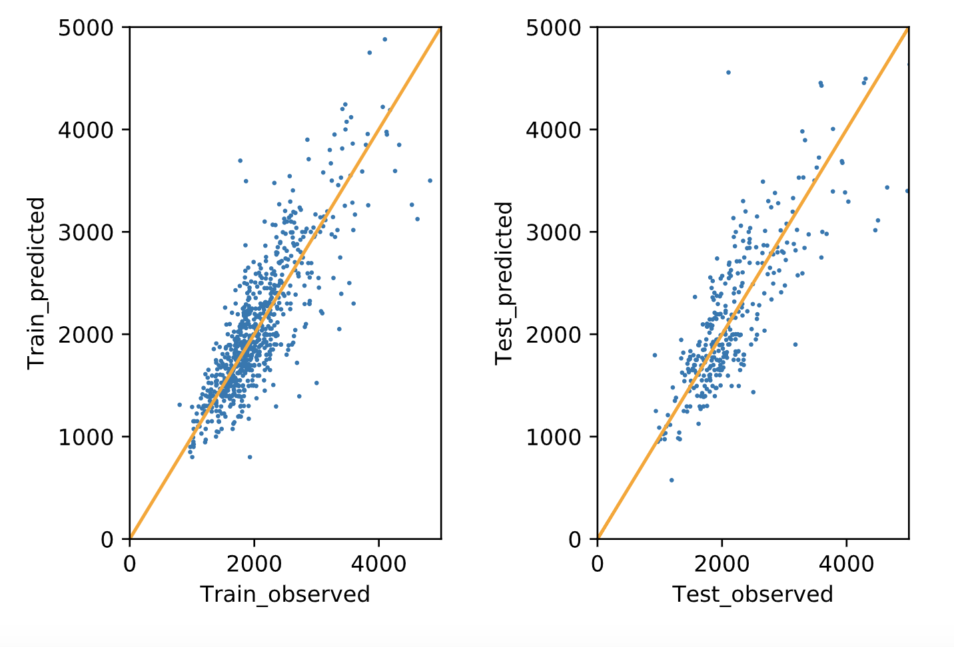
Train and Test
Train & Test Prediction vs. Observation

Slide 13
Future Work
Increase dataset
Incorporate more features
Create customized models for different property types

Slide 14
Thank You!

Slide 15
Appendix

Slide 16
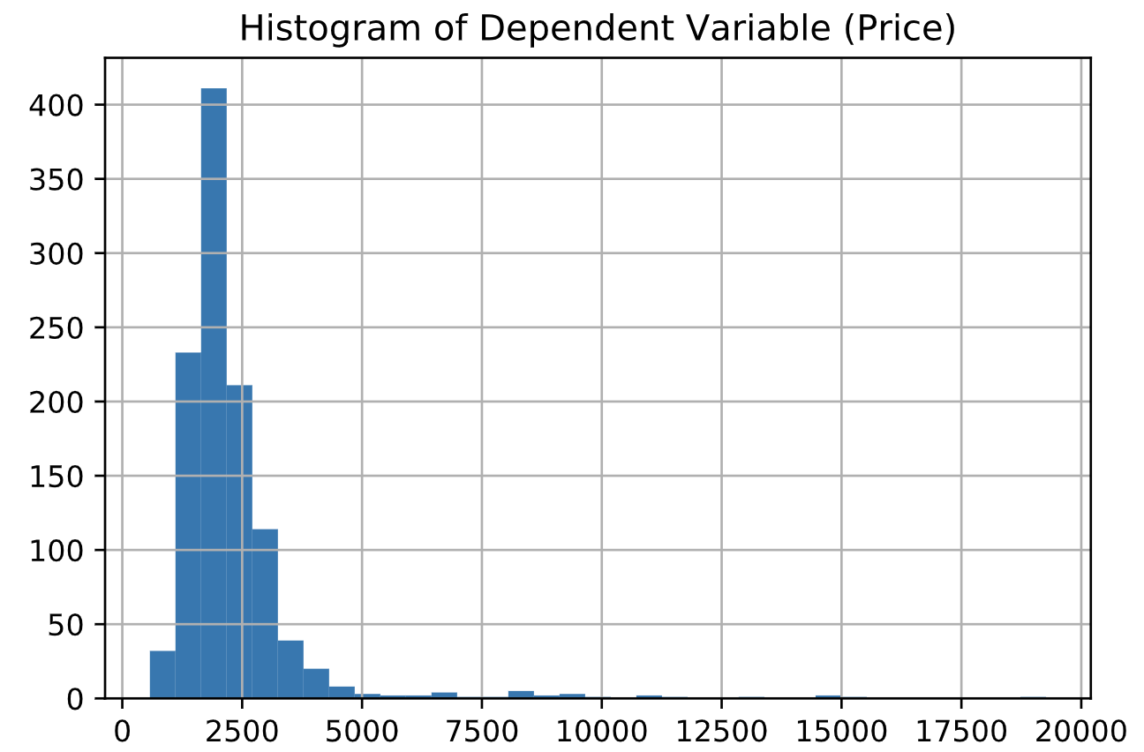
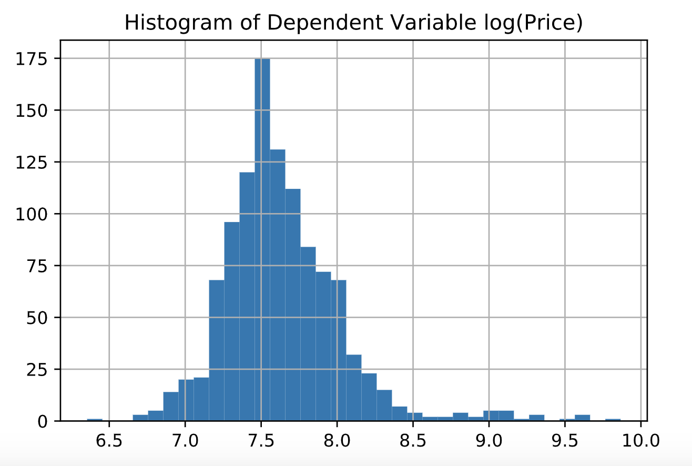
Model
Check heteroskedasticity
Distribution of y and log(y)

Slide 17
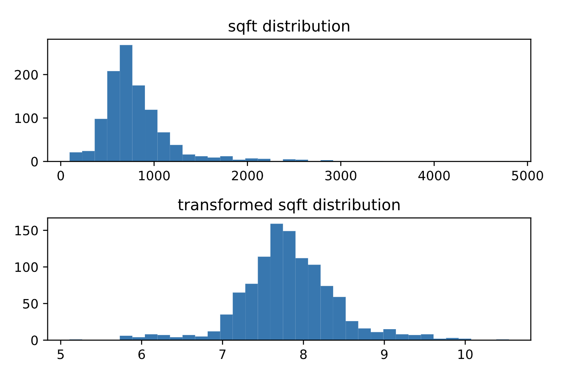
Model
Check heteroskedasticity
Distribution of Sqft and Boxcox transformed Sqft

